Slide 1
CRIMES IN CHICAGO
A Dataset from data.cityofchicago.org and contains data from 2001 - 2019

Slide 2
Time Series Analysis
On Assaults, Robbery and Thefts

Slide 3
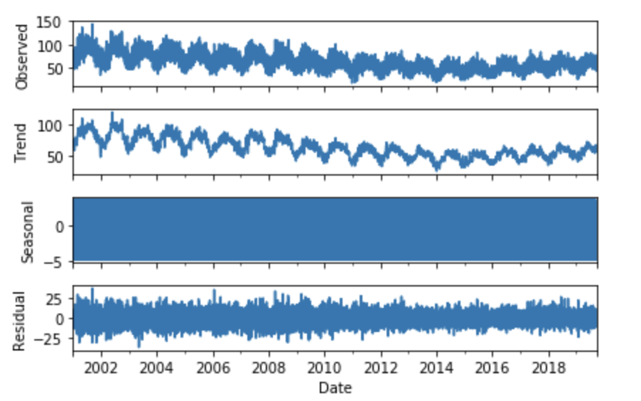
Time Series - Assaults
Add Fuller test: P-value = 2 %

Slide 4
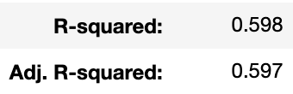
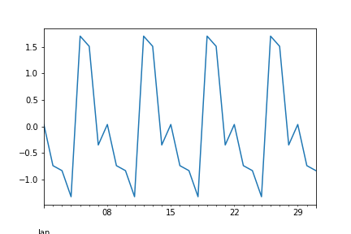
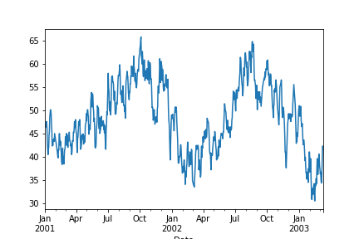
Time Series - Assaults
Seasonality
Trend
#Wednesday has by far the highest occurrences of assault.
#Sundays are very low.
# May-Aug increase
# Normally dropping in October

Slide 5
Time Series - Robbery
Add Fuller test: P-value= 0.4 %

Slide 6
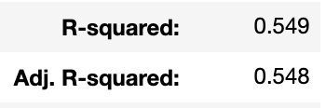
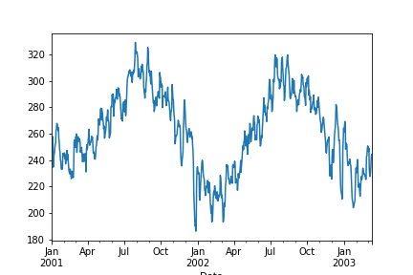
Time Series - Robbery
Seasonality
Trend
# Are the highest on Fridays and Saturdays.
# Steady in general, not that big differences in seasonality.
#February is the lowest month.
#July, August and September, robberies are the highest.

Slide 7
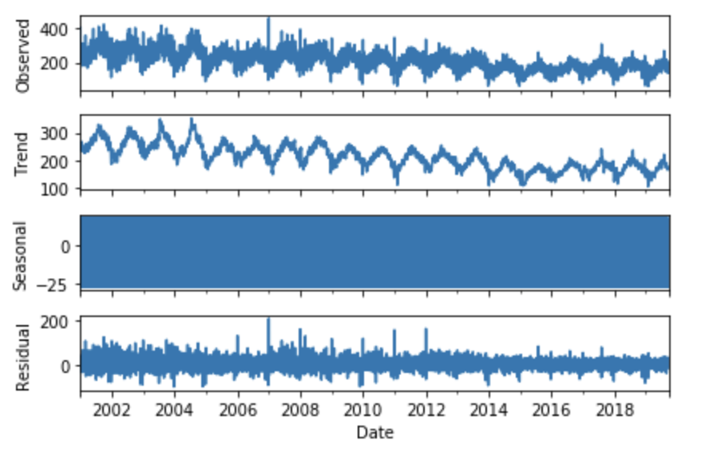
Time Series - Thefts
Add Fuller test: P-value= 3 %

Slide 8
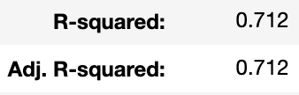
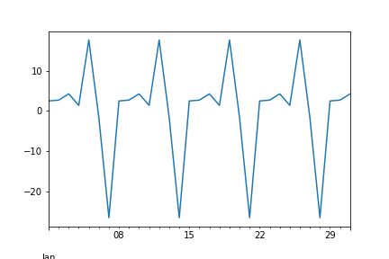
Time Series - Thefts
Seasonality
Trend
#Friday is Theft-Day
#Sundays are thieves resting day
#Peaks in June, July and August
#Hits bottom in February and then starts increasing.

Slide 9
Conclusion
# The analyzed crimes peak in occurrence during the warmest months and decreases distinctly during the coldest months.
# Theft, Robbery and Assaults are the lowest during weekends.
# All of the analyzed primary types of crime decrease over the years.

Slide 10
Thank You For Listening!

